Slide 1
How Insurers can use Flood Data for Risk Profiling
Presented by: VARUN PRASANNA RAO
Internship Period: 21st June 2022-19th August 2022

Slide 2
Table of Contents
Purpose Statement
Tools used to represent data
Understanding the Data
Conclusion

Slide 3
Purpose Statement

Slide 4
Objective
To help Insurers/Insurance company benefit from the Flood Data in their Risk Profiling Work using different data visualization techniques.

Slide 5
Data Visualization Tools used

Slide 6


POWER BI
Power BI is an interactive data visualization software product developed by Microsoft.
Power BI brings data to life.
Power BI easily connects to many data sources.
Power BI can provide business intelligence for all.
JUPYTER
JupyterLab is the latest web-based interactive development environment for notebooks, code, and data.
They are great for showcasing your work. You can see both the code and the results.
Very easy to host server side, which is useful for security purposes.

Slide 7
Presenting the data

Slide 8
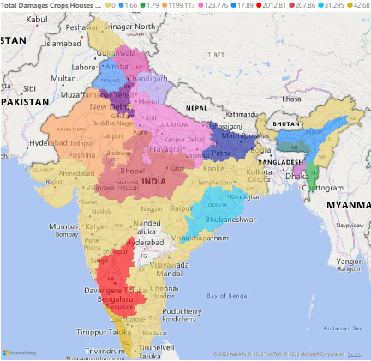
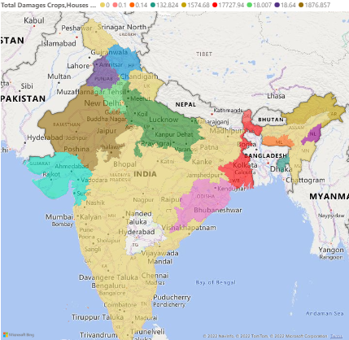
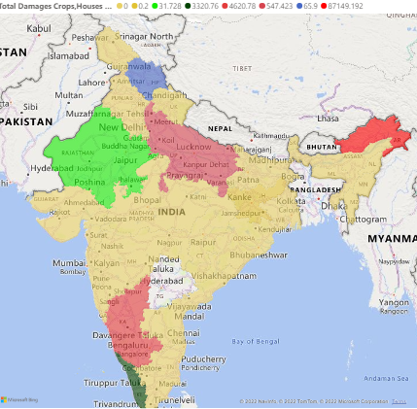
Understanding the Data
We have an India specific dataset related to the total damages that has been accounted for the year 2016-2018 because of the flood.
The dataset consists of many fields such as Loss of Public utilities, Loss of Crops, Loss of Houses etc.
2016
2017
2018

Slide 9
Conclusion

Slide 10
Intention behind the project...
Insurers usually keep in my mind the risk associated with a natural disaster, how the natural disaster is a threat to the organization and how can it be balanced so that there are no disruptions in the organization. There are some parameters that Insurers consider while Risk Profiling. They are;
Nature of the threat an organization faces
Degree to which the threat can impact the organization
Cost associated with the type of risk
The flood database will help the insurers understand the information related to the flood such as where the flood had occurred, what was the intensity of the flood, how it affected public utilities and how many lives were lost. It also gives information on what was the total damage caused due to floods, how the weather pattern has changed in a particular region due to unknown factors and so on. With the help of the above database, the Insurers can ensure that the following points are noted i.e.
Reimagining the risk evaluation
Improving the customer experience
Enhancing the efficiency and decision-making throughout the underwriting process
We were also able to show insights into the dataset provided to us using powerful data visualization tools such as Power BI. It not only showcased the data but also provided in-depth detail for the insurers to better understand the event that has occurred. Therefore, it can be concluded that the data plays an important role in helping Insurers in their Risk Profiling.

Slide 11
Thank You

